Slide 1
Discrete Mathematics
Dr. Han Huang
South China University of Technology
1

Slide 2
Chapter 5. Trees
Tree Traversal
Section 5.3
2

Slide 3
Contents
1
Introduction
2
Traversal Algorithms
3
Infix, Prefix, and Postfix Notation
3

Slide 4
Introduction
4

Slide 5
Ordered rooted trees
Ordered rooted trees are often used to store information.
We need procedures for visiting each vertex of an ordered rooted tree to access data.
Ordered rooted trees can also be used to represent various types of expressions, such as arithmetic expressions involving number, variables, and operations.

Slide 6
Universal Address Systems
Procedures for traversing all vertices of an ordered rooted tree rely on the orderings of children.
In ordered rooted trees, the children of an internal vertex are shown from left to right in the drawings representing these directed graphs.
We do this recursively :
1. Label the root with integer 0. Then label its k children (at level 1) from left to right with 1, 2, 3, …, k.
2. For each vertex v at level n with label A, label its kv children, as they are drawn from left to right, with A.1, A.2,…,A.k.

Slide 7
Example
0
1
2
3
4
5
3.1
3.2
1.1
1.2
1.3
4.1
5.1
5.2
5.3
3.1.2
3.1.1
3.1.3
3.1.2.1
3.1.2.3
3.1.2.4
3.1.2.2

Slide 8
Traversal Algorithm
8

Slide 9
Traversal algorithms
Procedures for systematically visiting every vertex of an ordered rooted tree are called traversal algorithms.
Preorder traversal.
Inorder traversal.
Postorder traversal.

Slide 10
Preorder Traversal
Definition 1: Let T be an ordered rooted tree with root r.
If T consists only of r, then r is the preorder traversal of T.
Otherwise, suppose that T1,T2,…,Tn are the subtree at r from left to right in T.
The preorder traversal begins by visiting r.

Slide 11
Preorder Traversal
It continues by traveling T1 in preorder, then T2 in preorder, then T2 in preorder, and so on, until Tn is traversed in preorder.
Step1: Visit r
T1
T2
Tn
……
Step2: Visit T1
Step3: Visit T2
Step n: Visit Tn

Slide 12
Example
Does a preorder traversal visit the vertices in the ordered rooted tree T ?
a
f
a
b
c
b
c
d
e
d
j
g
e
f
g
h
i
k
l
m
n
m
j
k
l
o
h
p
i
n
o
p

Slide 13
Algorithm 1: Preorder Traversal
Procedure preorder (T: ordered rooted tree)
r : = root of T
List r
For each child c of r from left to right
Begin
T(c) : = subtree with c as its root
preorder(T(c))
End

Slide 14
Inorder Traversal
Definition 2: Let T be an ordered rooted tree with root r.
If T consists only of r, then r is the inorder traversal of T.
Otherwise, suppose that T1,T2,…,Tn are the subtree at r from left to right.
The inorder traversal begins by traversing T1 inorder, then visiting r.
It continues by traversing T2 in inorder, then T3 in inorder,…, and finally Tn in inorder.

Slide 15
Example
Does a inorder traversal visit the vertices in the ordered rooted tree T ?
j
a
a
e
c
n
l
b
c
d
k
g
e
o
m
f
g
h
i
p
d
m
b
h
j
k
l
f
i
n
o
p

Slide 16
Algorithm 2: Inorder Traversal
Procedure inorder (T: ordered rooted tree)
r : = root of T
if r is a leaf then list r
Else Begin
l : = first child of r from left to right
T(l) : = subtree with l as its root
inorder(T(l))
list r
for each child c of r except for l from left to right
T(c) : = subtree with c as its root
inorder(T(c))
End

Slide 17
Postorder Traversal
Definition 3: Let T be an ordered rooted tree with root r.
If T consists only of r, then r is the postorder traversal of T.
Otherwise, suppose that T1,T2,…,Tn are the subtree at r from left to right.
The postorder traversal begins by traversing T1 postorder.
It continues by traversing T2 in postorder, then T3 in postorder,…, and finally Tn in postorder.

Slide 18
Example
Does a postorder traversal visit the vertices in the ordered rooted tree T ?
a
j
b
n
c
b
c
d
o
l
p
m
e
f
g
h
i
k
g
e
h
k
l
m
f
i
j
d
a
n
o
p

Slide 19
Algorithm 1: Postorder Traversal
Procedure postorder (T: ordered rooted tree)
r : = root of T
For each child c of r from left to right
Begin
T(c) : = subtree with c as its root
postorder(T(c))
End
List r

Slide 20
Infix, Prefix, and Postfix Notation
20

Slide 21
Representation of expression
+ addition
- subtraction
* multiplication
/ division
↑ exponentiation

Slide 22
Example 1
Use the ordered rooted tree to represent the expression ((x+y)↑2)+((x-4)/3) ?
+
↑
/
-
+
2
3
x
y
x
4

Slide 23
Infix form
To make such expressions unambiguous it is necessary to include parentheses in the inorder traversal whenever we encounter an operation.
The fully parenthesized expression obtained in this way is said to be in infix form.

Slide 24
Example
(x+y) / (x+3) (x+(y/x))+3 x+(y/(x+3))
+
+
/
+
3
x
/
+
+
x
/
y
+
x
y
x
3
y
x
x
3

Slide 25
Prefix form
We obtain the prefix form of an expression when we traverse its rooted tree in preorder.
Expression written in prefix from are said to be in Polish notation, which is named after the Polish logician Jan Lukasiewicz.

Slide 26
Example 1
What is the prefix form for the expression ((x+y)↑2)+((x-4)/3) ?
Solution : + ↑+ x y 2 / - x 4 3
+
↑
/
-
+
2
3
x
y
x
4

Slide 27
Example 2
What is the value of the prefix expression + - * 2 3 5 / ↑2 3 4 ?
+
-
/
↑
*
5
4
2
3
2
3
( (2 * 3) – 5) + ((2↑3) / 4) = 1 + 2 =3

Slide 28
Postfix form
We obtain the postfix form of an expression by traversing its binary tree in postorder.
Expression written in postfix from are said to be in reserve Polish notation.
Expression in reserve Polish notation are unambiguous, so parentheses are not needed.

Slide 29
Example 1
What is the postfix form for the expression ((x+y)↑2)+((x-4)/3) ?
Solution : x y + 2 ↑x 4 – 3 / +
+
/
↑
-
+
2
3
x
y
x
4

Slide 30
Example 2
What is the value of the postfix expression 7 2 3 * - 4 ↑9 3 / + ?
+
↑
/
-
4
9
3
7
*
2
3
( 7 - (2 * 3))↑4 + (9 / 3) = 1 + 3 = 4

Slide 31
Example 3
Find the ordered rooted tree representing the compound proposition (¬(p ∧ q)) ↔ (¬p ∨ ¬ q) .
Then use this rooted tree to find the prefix, postfix, and infix forms of this expression.
↔
¬
∨
∧
¬
¬
p
q
p
q

Slide 32
Example
↔
¬
∨
∧
¬
¬
p
q
p
q
Preorder : ↔ ¬ ∧ p q ∨ ¬ p ¬ q
Postorder: p q ∧ ¬ p ¬ q ¬ ∨ ↔
Inorder : (¬ (p ∧ q)) ↔ ((¬ p ) ∨ (¬ q ))

Slide 33
Applications
33

Slide 34
Applications
1.用有序树表达代数表达式
/
∧
*
a
-
-
5
∧
*
*
*
∧
b
3
4
c
3
x
5
y
2

Slide 35
Applications
and
-
*
*
a
-
*
a
∧
a
*
∧
*
b
3
4
c
b
3
4
c

Slide 36
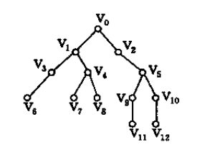
Applications
2.使用3种遍历方法对下面的树进行遍历。

Slide 37
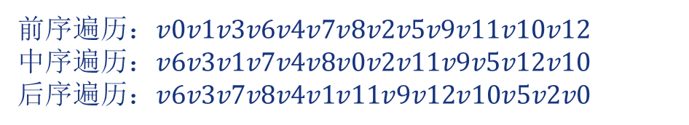
Applications
2.使用3种遍历方法对下面的树进行遍历。
前序遍历：$v0v1v3v6v4v7v8v2v5v9v11v10v12$
中序遍历：$v6v3v1v7v4v8v0v2v11v9v5v12v10$
后序遍历：$v6v3v7v8v4v1v11v9v12v10v5v2v0$

Slide 38
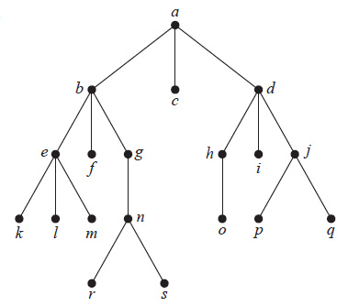
Exercises
1. Determine the order in which a preorder traversal visits the vertices of the given ordered rooted tree.
a, b, e, k, l, m, f, g, n, r, s, c, d, h, o, i, j, p, q
Notes:
好像涉及树

Slide 39
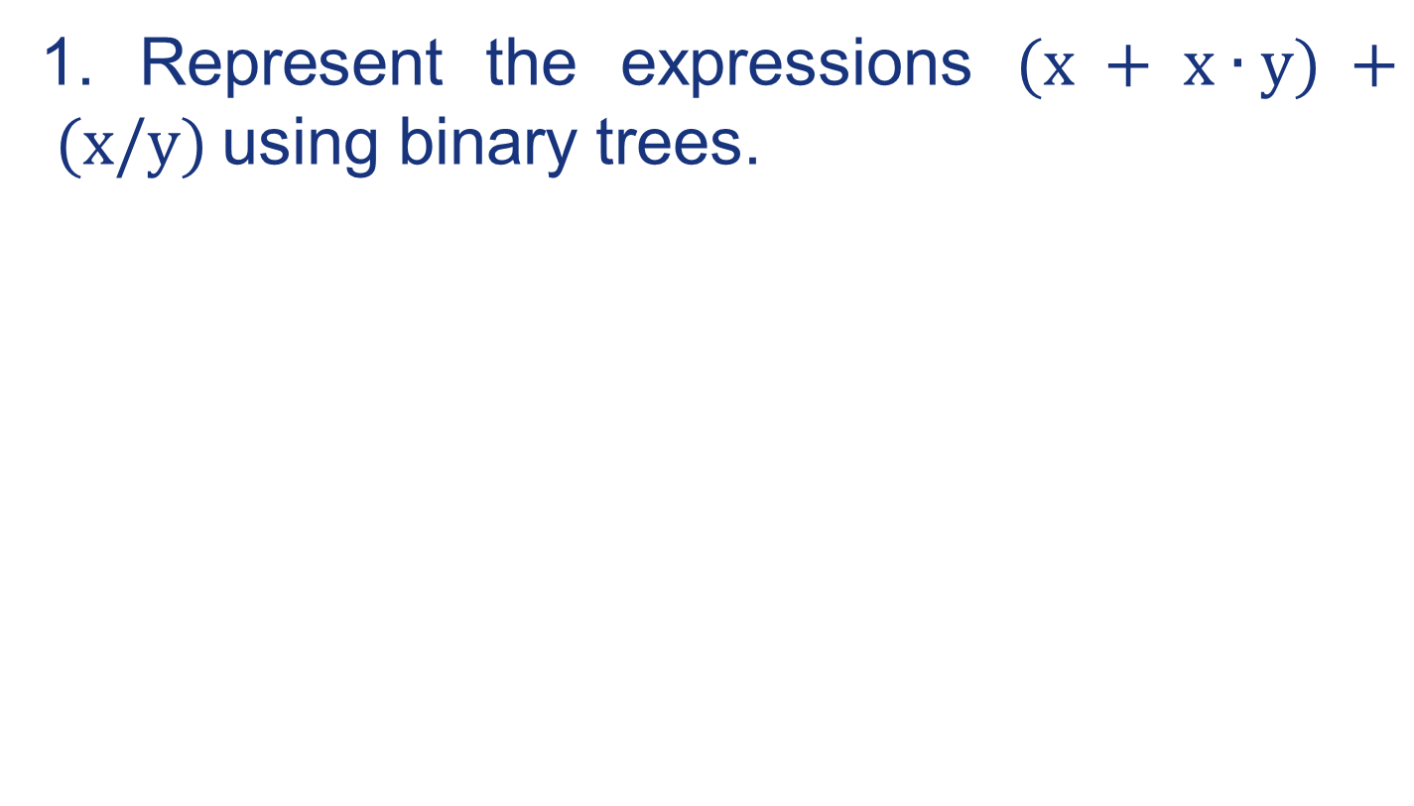
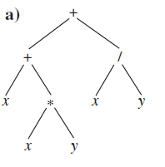
Exercises
2.
Notes:
好像涉及树

Slide 40
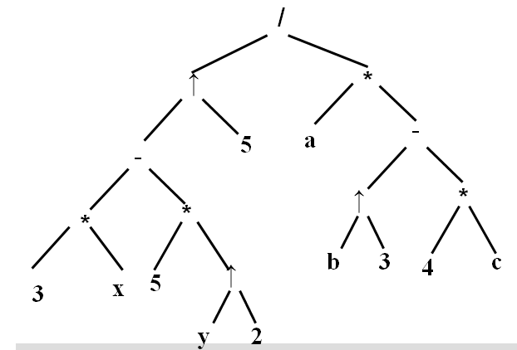
Exercises
3. Use the ordered rooted tree to represent the expression ((3*x-5*(y↑2))↑5)/(a*((b↑3)-4*c))
Notes:
好像涉及树

Slide 41
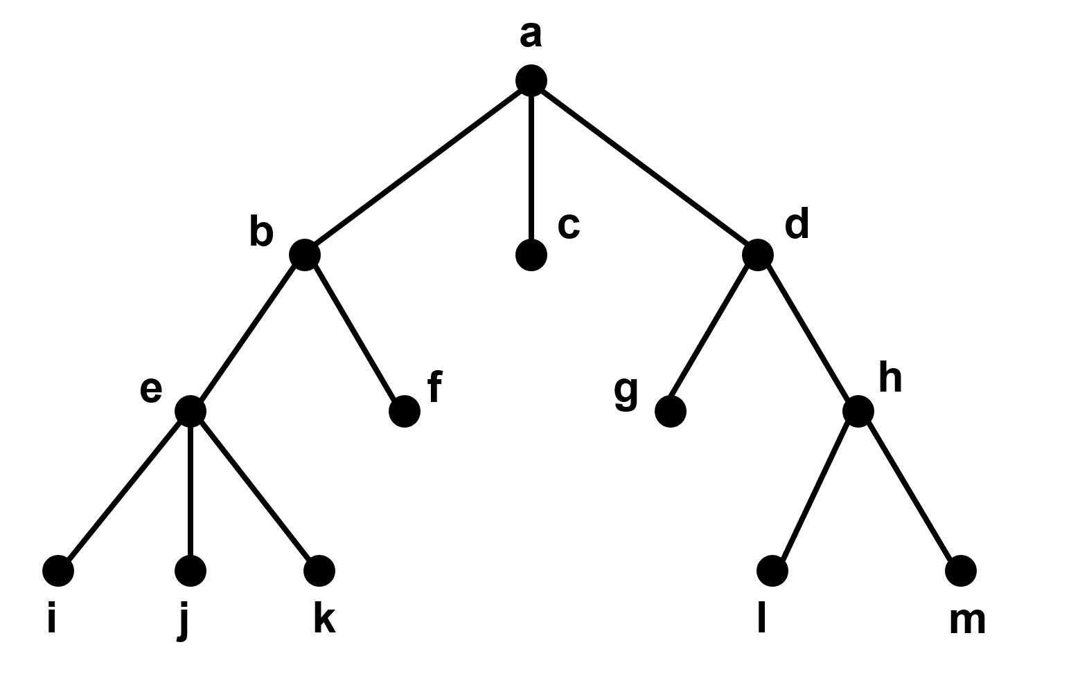
Exercises
4. Determine the order in which an inorder traversal visits the vertices of the given ordered rooted tree in Figure __________
i e j k b f a c g d l h m
Notes:
好像涉及树

Slide 42
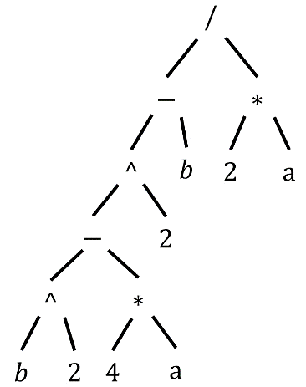
Exercises
5. Find the infix form of the expression given by the rooted tree of Figure _________
((b^2-4*a)^2-b)/(2*a)
Notes:
好像涉及树

Slide 43
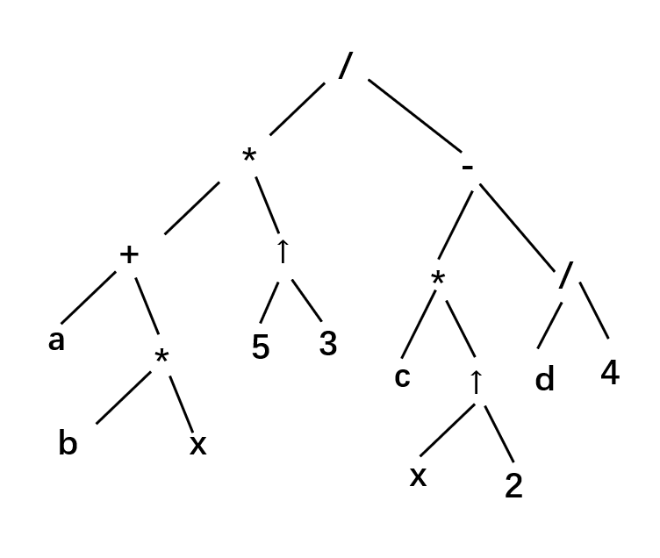
Exercises
6.
Notes:
好像涉及树

Slide 44
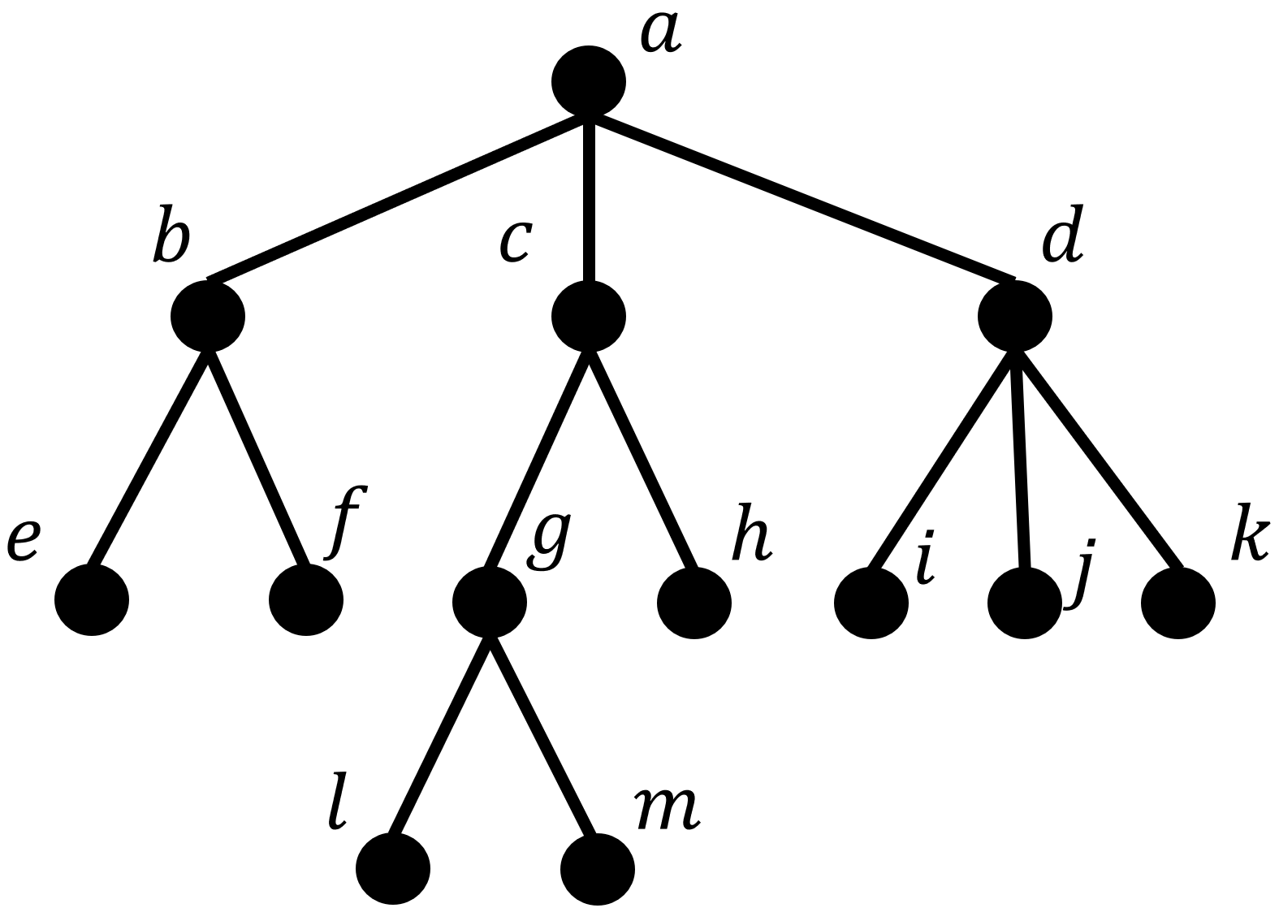
Exercises
7. Please determine the order in which a preorder traversal and a postorder traversal visit the vertices of the ordered rooted tree in Figure.
Preorder：a b e f c g l m h d i j k
Postorder：e f b l m g h c i j k d a
Notes:
好像涉及树

Slide 45
End of Section 5.3
Click to edit company slogan .
45

